Slide 1


PSEA Core Principles

Slide 2

No Sex with Beneficiaries: Any sexual relationship between those providing humanitarian assistance and protection and a person benefiting from such humanitarian assistance and protection that involves improper use of rank or position is prohibited. Such relationships undermine the credibility and integrity of humanitarian aid work.

Slide 3
Always Report SEA: Where a humanitarian worker develops concerns or suspicions regarding sexual abuse or exploitation by a fellow worker, whetherin the same agency or not, he or she must report such concerns via established agency reporting mechanisms.

Slide 4
Discourage SEA Around You: Humanitarian workers are obliged to create and maintain an environment that prevents sexual exploitation and abuse and promotes the implementation of their code of conduct. Managers at all levels have responsibilities to support and develop systems which maintain this environment.

Slide 5
No Second Chances: Sexual exploitation and abuse by humanitarian workers constitute acts of gross misconduct and are therefore grounds for termination of employment.

Slide 6
No Sex with Children: Sexual activity with children (persons under the age of 18) is prohibited regardless of the age of majority or age of consent locally. Mistaken belief regarding the age of a child is not a defense.

Slide 7
Don’t Exchange Anything For Sex: Exchange of money, employment, goods, or services for sex, including sexual favors or other forms of humiliating, degrading or exploitative behavior is prohibited. This includes exchange of assistance that is due to beneficiaries.

Slide 8

Mix and Match
Note: These apply 24/7 to every aid worker
or related personnel to NABAD.

Slide 9

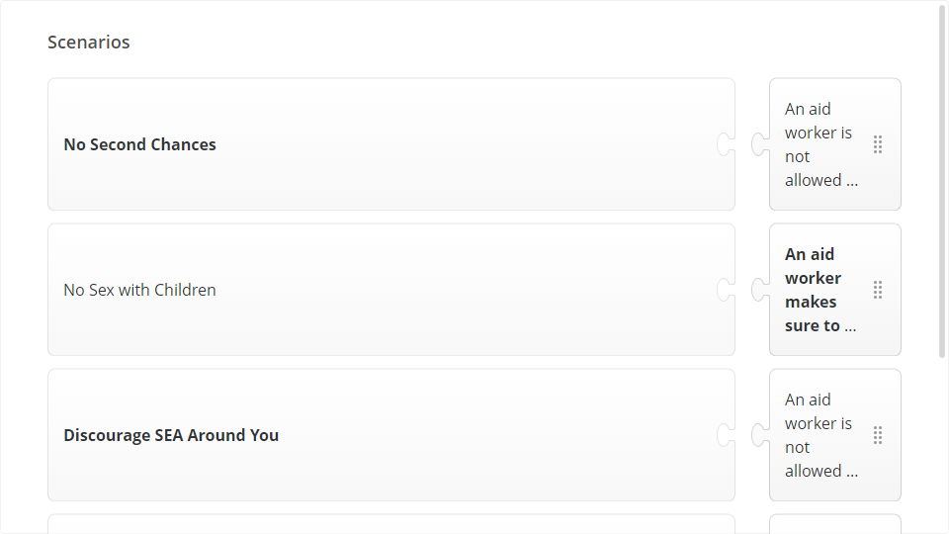
Quiz
Click the Quiz button to edit this object

Slide 10
Next Lesson

